Slide 1
Single stain intensity, with or without a second stain type
3way ANOVAs can be found in the pdf.
Significance is not indicated on figures (this slide deck is just for convenience).

Slide 2
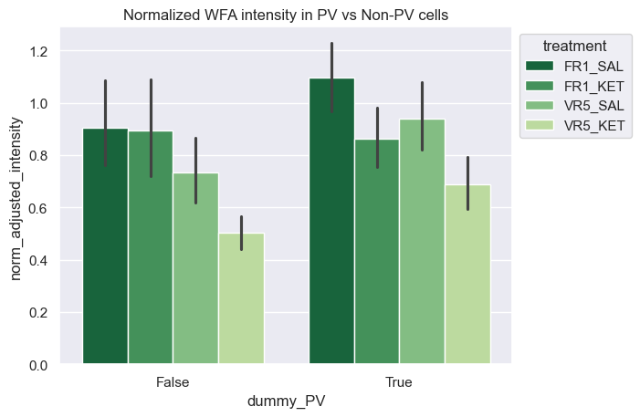
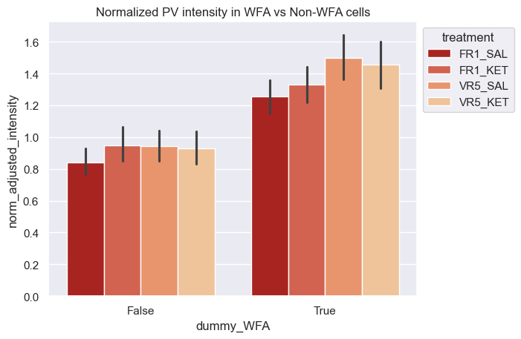
WFA/PV±, PV/WFA± normalized intensity

Slide 3
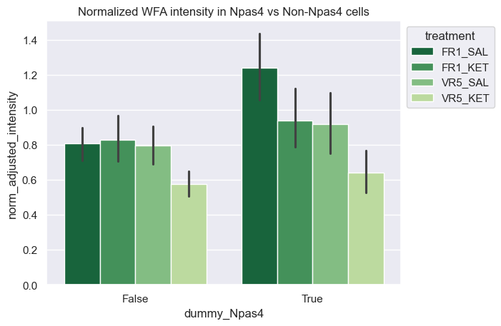
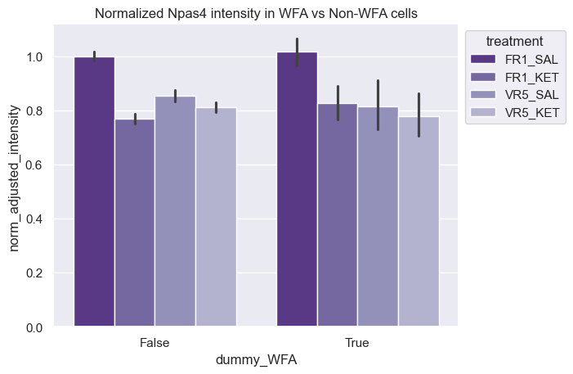
WFA/Npas4±, Npas4/WFA± normalized intensity

Slide 4
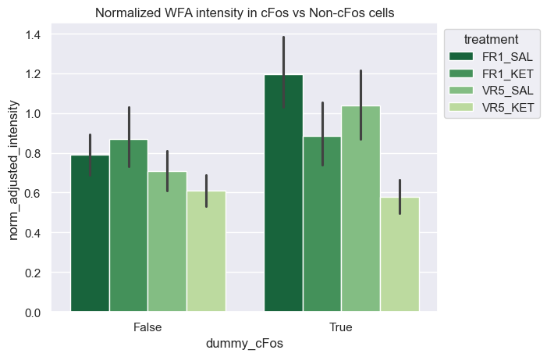
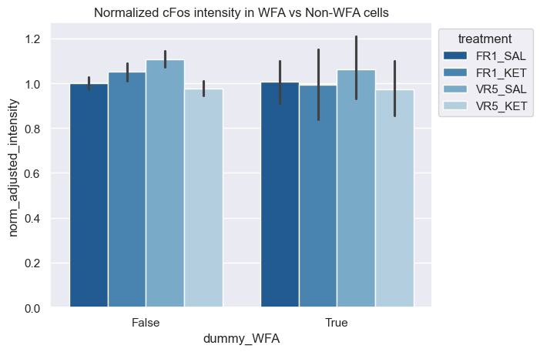
WFA/cFos±, cFos/WFA± normalized intensity

Slide 5
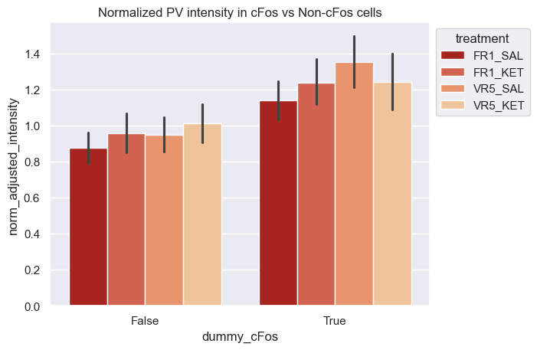
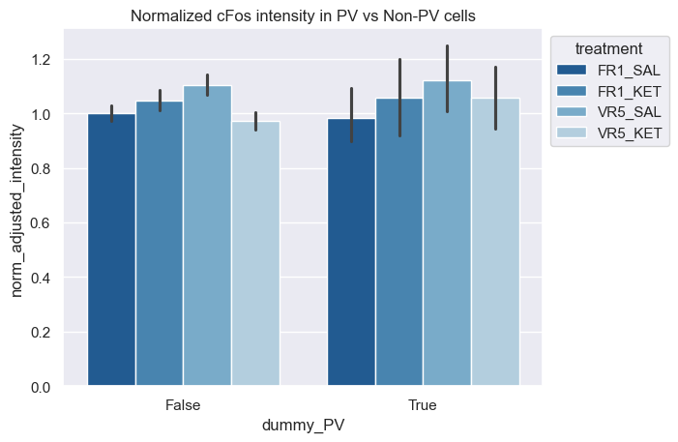
PV/cFos±, cFos/PV± normalized intensity

Slide 6
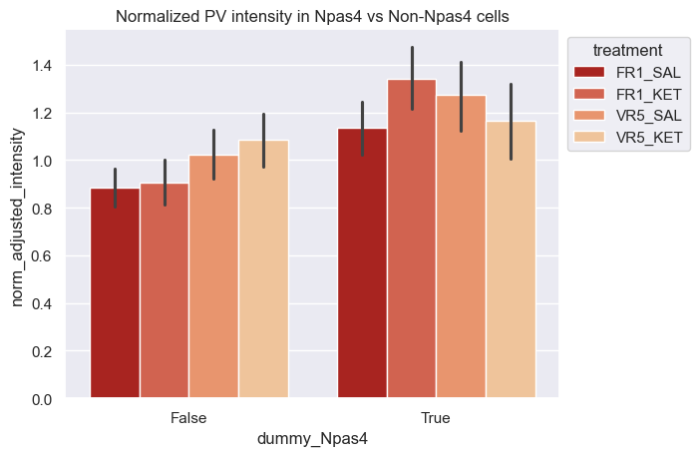
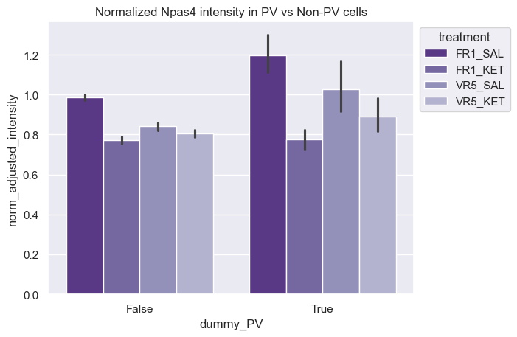
PV/Npas4±, Npas4/PV± normalized intensity

Slide 7
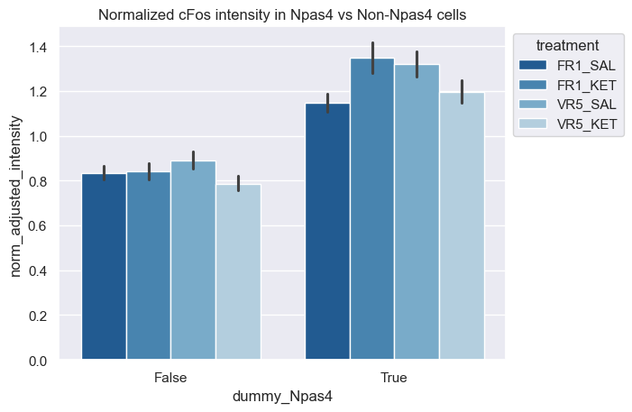
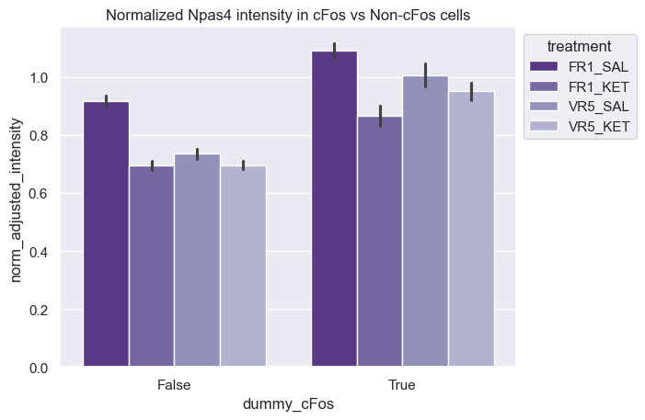
cFos/Npas4±, Npas4/cFos± normalized intensity

Slide 8
Double stain intensity, with or without a third stain type
3way ANOVAs can be found in the pdf.
Significance is not indicated on figures (this slide deck is just for convenience).

Slide 9
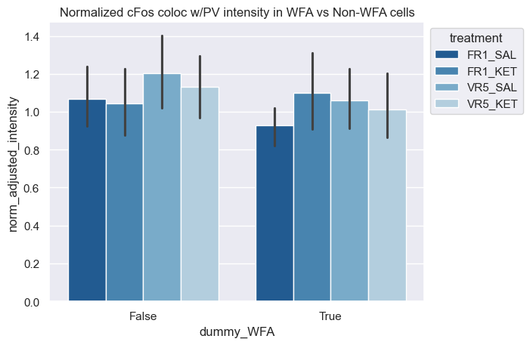
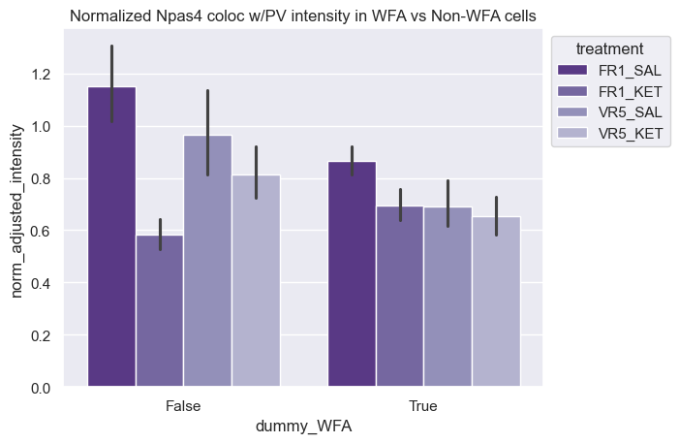
cFos, Npas4 intensity in PV cells with or without WFA

Slide 10
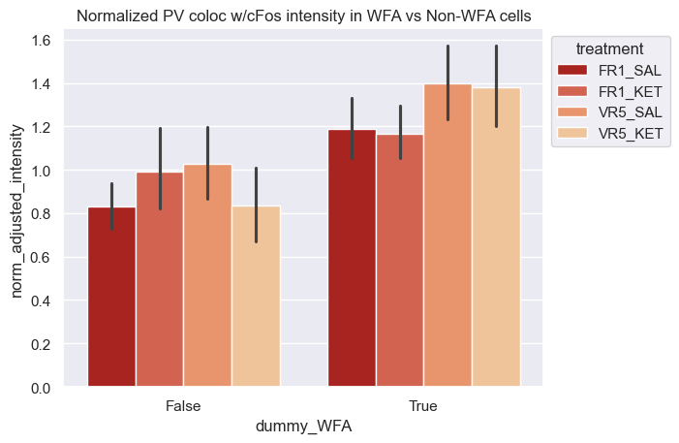
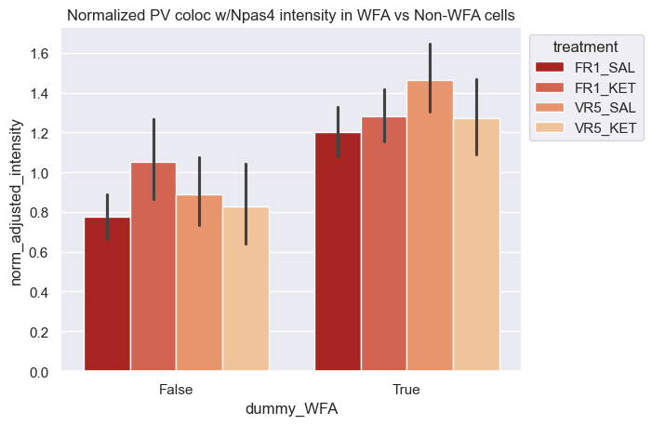
PV intensity in cFos, Npas4 cells with or without WFA

Slide 11
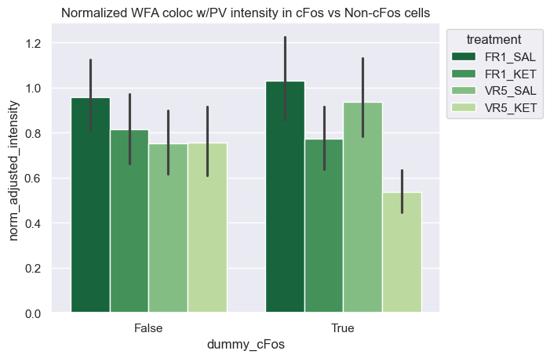
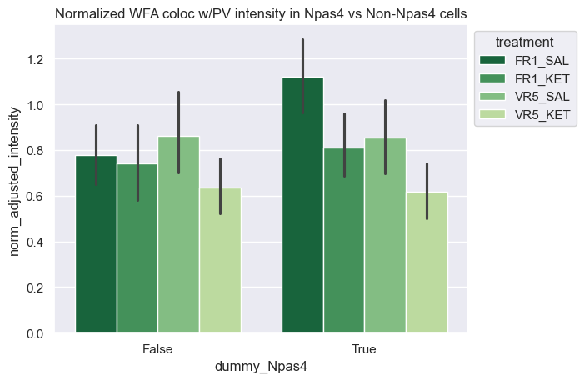
WFA intensity in PV cells with or without cFos, Npas4

Slide 12
Single stain intensity, binned by cFos or Npas4 (high/low)
3way ANOVAs can be found in the pdf.
Significance is not indicated on figures (this slide deck is just for convenience).

Slide 13
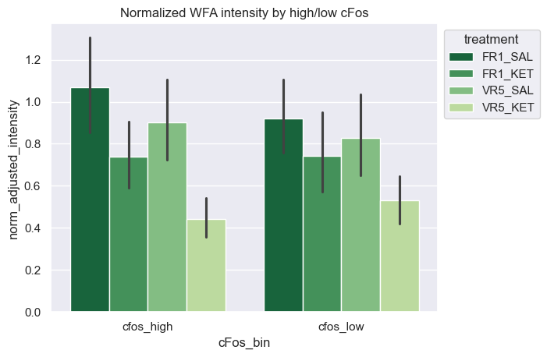
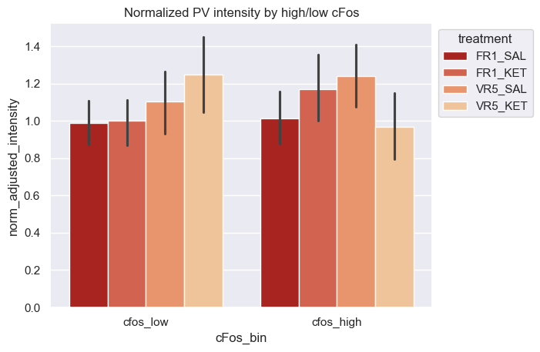
WFA, PV intensity binned by high/low cFos
The three way interaction effect for PV is significant here, see ANOVA table in pdf

Slide 14

WFA, PV intensity binned by high/low cFos

Slide 15
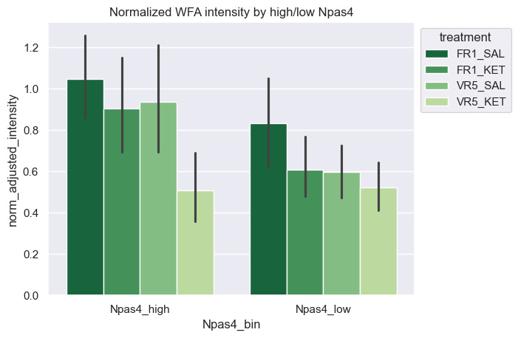
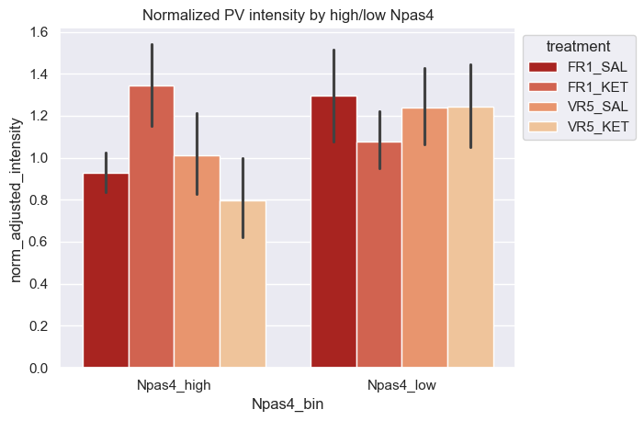
WFA, PV intensity binned by high/low Npas4

Slide 16
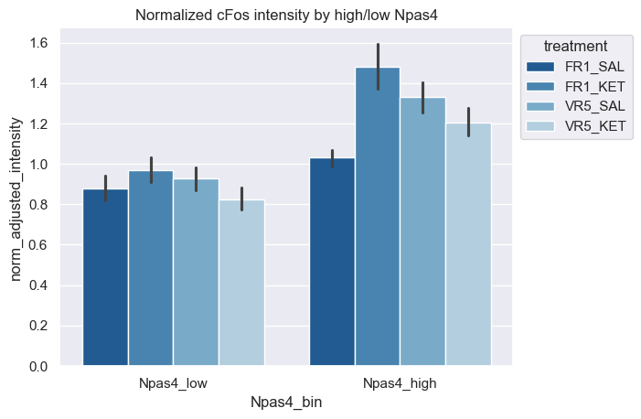
cFos intensity binned by high/low Npas4

Slide 17
Double PV/WFA binned by high/low cFos or Npas4
I also plotted double PV/WFA intensity binned by high/low cFos or Npas4 but there were no significant 3way interaction effects and so they are not shown here. You can find them at the end of the attached pdf.

